Slide 1
BANKING & FINANCIAL SERVICES
BANK ANALYTICS
End-to-End Banking Analytics using SQL, Excel, Power BI & Tableau
SQL
EXCEL
POWER BI
TABLEAU

Slide 2









01
02
03
Introduction
Key Performance Indicators (KPIs)
Excel Dashboard
04
05
06
CONTENTS
Table of
Contents
Power BI Dashboard
Tableau Dashboard
SQL Queries & Results
07
08
09
Challenges Faced
Conclusion
Thank You
BANK ANALYTICS
02

Slide 3


PROJECT OVERVIEW
01. Introduction
PROJECT BACKGROUND
CORE OBJECTIVES
The Bank Analytics Dashboard transforms raw banking loan data into actionable business insights using SQL, Excel, Power BI and Tableau. It consolidates loan, revenue, and branch-level data into a single analytical view for management reporting.
The solution replaces manual, time-consuming analysis with an automated, end-to-end reporting pipeline — giving leadership a clear, real-time picture of loan performance, revenue and operational efficiency across every branch.
1
Analyze loan performance and portfolio health across branches
2
Track revenue, interest income and fee collection trends
3
Evaluate branch efficiency and product distribution
4
Understand customer and loan disbursement trends
5
Automate reporting to reduce manual analysis effort
6
Support data-driven decision-making for leadership
BANK ANALYTICS
03

Slide 4











METRICS TRACKED
02. Key Performance Indicators (KPIs)
Core metrics powering the loan, revenue and branch-performance dashboards across every tool in the pipeline.
Total Loans
Total Funded Amount
Total Amount Received
Interest
Fees
Verified Loans
Default Loans
Delinquent Loans
Branch Performance
Product Distribution
Disbursement Trend
BANK ANALYTICS
04

Slide 5
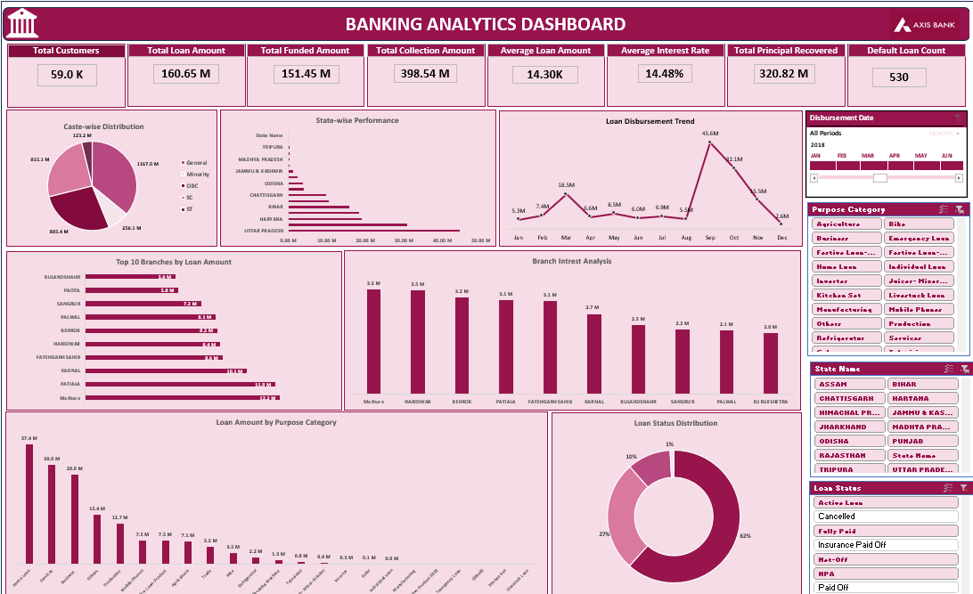

BUSINESS REPORTING
03. Excel Dashboard – Bank Analytics
Pivot-driven reporting layer for loan and revenue analysis — built for fast, self-service exploration by business users.
EXCEL DEVELOPMENT
The first step of our project was cleaning the raw banking dataset in Excel by removing duplicate records, handling missing values, and standardizing the data.
Using the cleaned dataset, we developed the Bank Analytics Dashboard to analyze loan performance, branch performance, revenue, customer trends, and product distribution.
Excel Features Used
Pivot Tables
Pivot Charts
KPI Cards
Slicers
Conditional Formatting
These features enabled interactive analysis, filtering, and reporting for faster business decision-making.
INSERT DASHBOARD SCREENSHOT HERE
Excel · Loan & revenue dashboard — place full-resolution screenshot here
BANK ANALYTICS
05

Slide 6
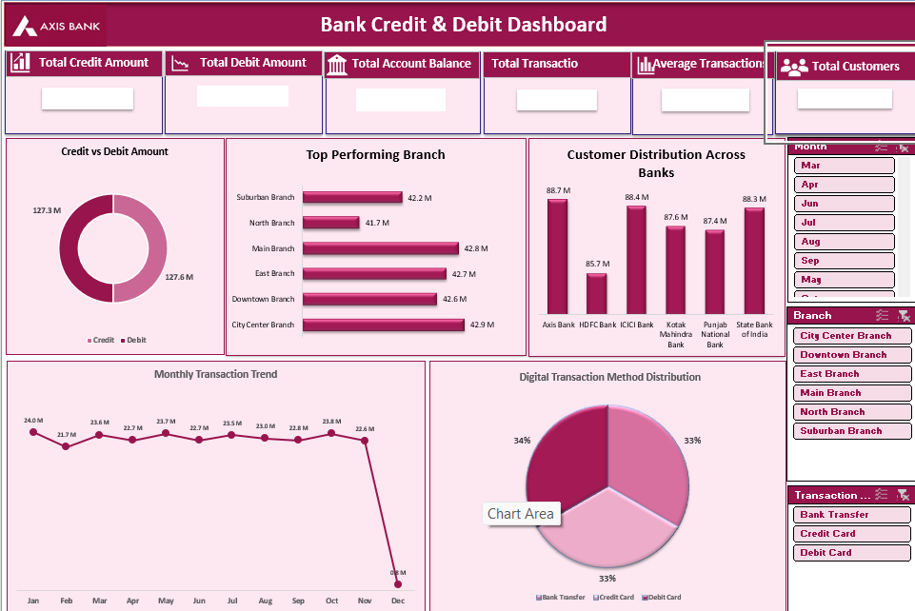
BUSINESS REPORTING
Excel – Credit & Debit Dashboard
Pivot-driven reporting layer for loan and revenue analysis — built for fast, self-service exploration by business users.
EXCEL DEVELOPMENT
Using the same cleaned dataset, we developed the Credit & Debit Dashboard in Excel to monitor credit transactions, debit transactions, account balances, customer distribution, branch performance, and monthly transaction trends.
Excel Features Used
Pivot Tables
Pivot Charts
KPI Cards
Slicers
Conditional Formatting
The dashboard provides an interactive overview of customer banking activities and transaction performance.
INSERT DASHBOARD SCREENSHOT HERE
Credit & Debit Dashboard — place full-resolution screenshot here
BANK ANALYTICS
06

Slide 7
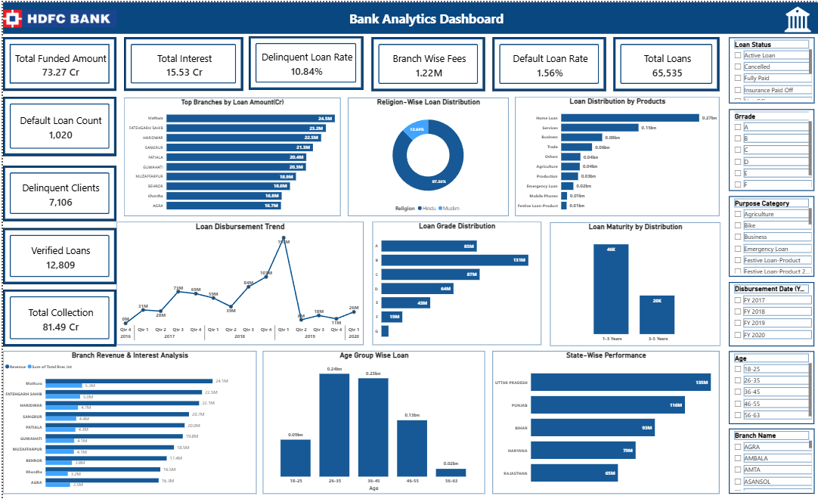

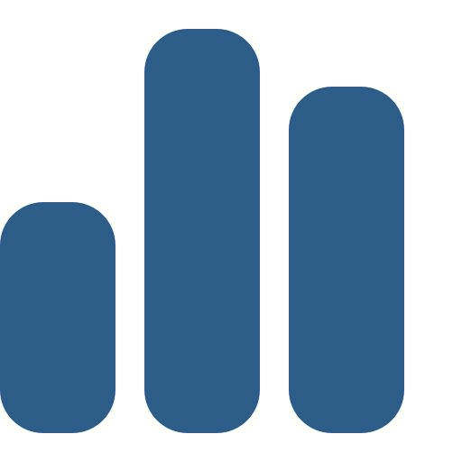
MODELING & INTERACTIVITY
04. Power BI Dashboard – Bank Analytics
A modeled semantic layer with custom DAX measures, powering interactive executive dashboards with drill-through detail.
POWER BI DEVELOPMENT
The cleaned Excel dataset was imported into Power BI.
We created relationships between tables and developed DAX measures to calculate KPIs and business metrics.
Power BI Features Used
Data Modeling
Relationships
DAX Measures
KPI Cards
Interactive Filters
Drill-through Reports
These features provide dynamic reports and real-time business insights for banking performance.
INSERT DASHBOARD SCREENSHOT HERE
Power BI · Executive dashboard — place full-resolution screenshot here
BANK ANALYTICS
07

Slide 8
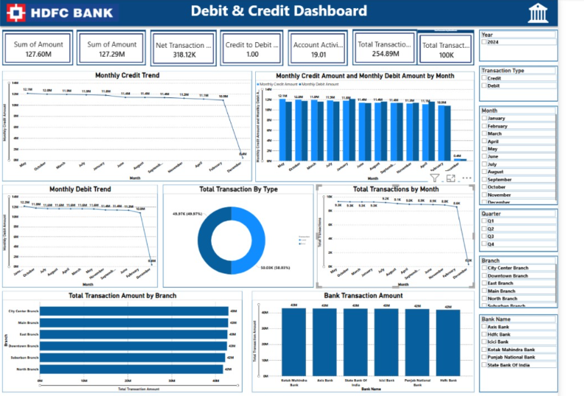
MODELING & INTERACTIVITY
Power BI – Credit & Debit Dashboard
A modeled semantic layer with custom DAX measures, powering interactive executive dashboards with drill-through detail.
POWER BI DEVELOPMENT
Using the same cleaned dataset, we created the Credit & Debit Dashboard in Power BI to analyze customer transactions, balances, branch performance, and monthly transaction trends.
Power BI Features Used
Data Modeling
Relationships
DAX Measures
KPI Cards
Interactive Filters
Drill-through Reports
The dashboard enables real-time transaction monitoring and interactive business analysis.
INSERT DASHBOARD SCREENSHOT HERE
Credit & Debit Dashboard — place full-resolution screenshot here
BANK ANALYTICS
08

Slide 9
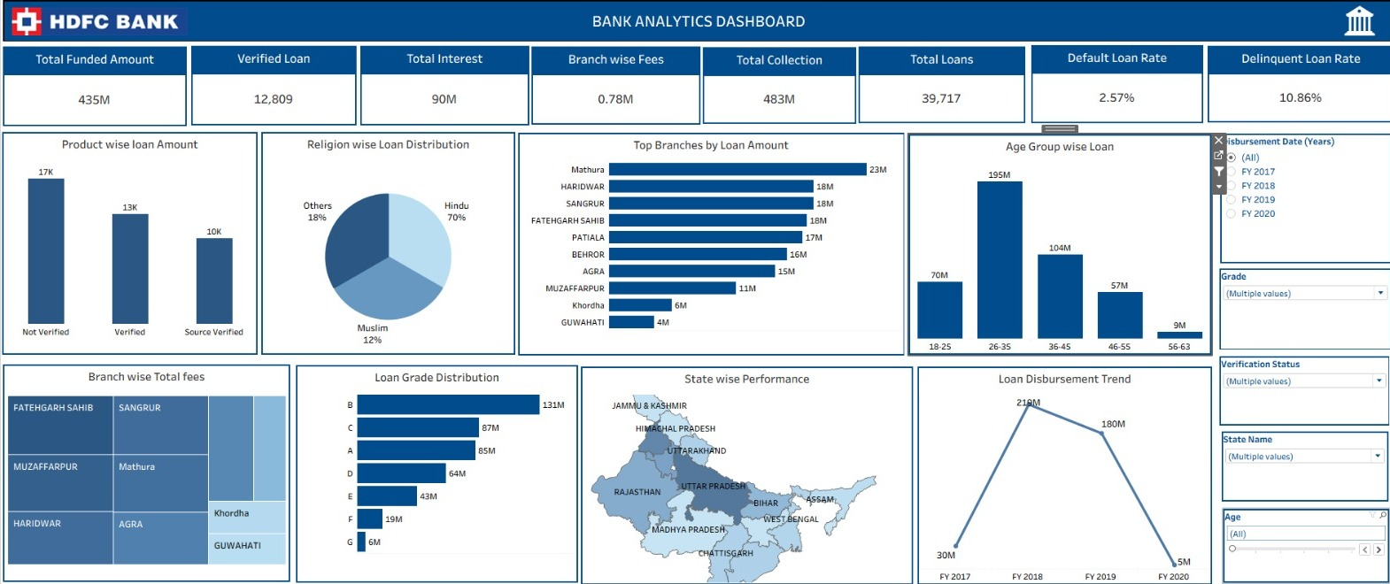

VISUAL ANALYTICS
05. Tableau Dashboard – Bank Analytics
Interactive visualizations breaking down loan and disbursement data across geography, branch and product dimensions.
TABLEAU DEVELOPMENT
The cleaned dataset was imported into Tableau to create interactive visual analytics for loan performance, branch performance, product distribution, and customer trends.
Tableau Features Used
Interactive Dashboards
Filters
Parameters
Charts
Maps
Calculated Fields
These visualizations help management identify trends and make informed decisions quickly.
INSERT DASHBOARD SCREENSHOT HERE
Tableau · Interactive visualization — place full-resolution screenshot here
BANK ANALYTICS
09

Slide 10
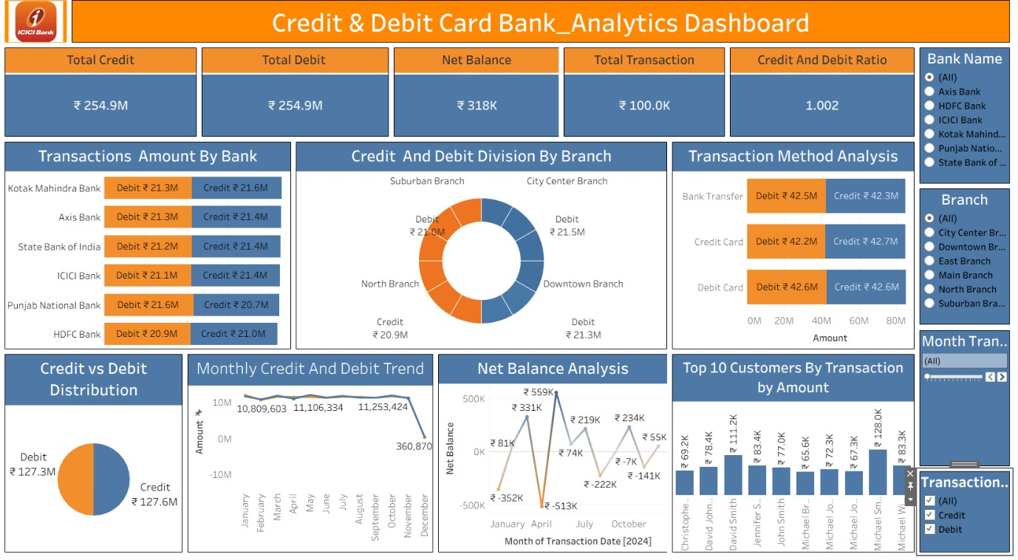
VISUAL ANALYTICS
Tableau – Credit & Debit Dashboard
Interactive visualizations breaking down loan and disbursement data across geography, branch and product dimensions.
TABLEAU DEVELOPMENT
Using the same cleaned dataset, we developed the Credit & Debit Dashboard to visualize customer transactions, account balances, branch-wise performance, and monthly banking activities.
Tableau Features Used
Interactive Dashboards
Filters
Parameters
Charts
Calculated Fields
The dashboard presents transaction data through rich and interactive visual analytics.
INSERT DASHBOARD SCREENSHOT HERE
Credit & Debit Dashboard — place full-resolution screenshot here
BANK ANALYTICS
10

Slide 11
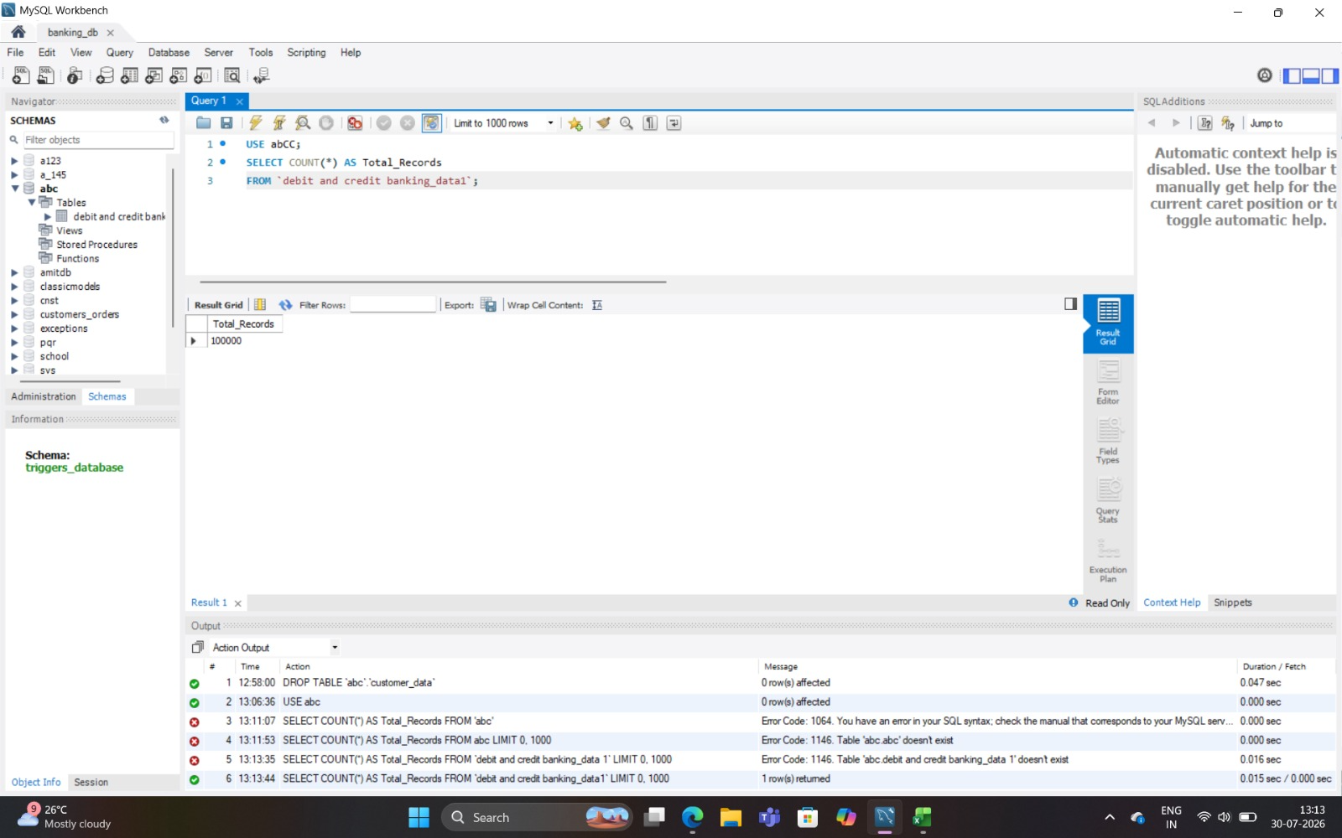

RELATIONAL DATA EXTRACTION
06. SQL Queries & Results
SQL formed the foundation of the pipeline — extracting, cleaning, filtering and joining raw loan data to prepare KPI-ready datasets.
SQL ANALYSIS
After completing all dashboards, we used the same cleaned dataset in SQL to perform business analysis and validate dashboard insights.
SQL Queries Used
SELECT – Retrieved required banking records.
WHERE – Filtered data based on business conditions.
GROUP BY – Grouped records for KPI calculations.
ORDER BY – Sorted results for reporting.
JOIN – Combined multiple related tables.
COUNT() – Calculated total records.
SUM() – Computed total loan, revenue and transaction values.
AVG() – Calculated average loan and transaction values.
These SQL queries generated KPI summaries, business reports, and analytical insights that supported the Excel, Power BI, and Tableau dashboards.
INSERT DASHBOARD SCREENSHOT HERE
SQL · KPI-ready dataset / query results — place full-resolution screenshot here
BANK ANALYTICS
11

Slide 12




CHALLENGES & RESOLUTIONS
07. Challenges Faced
Data Cleaning
KPI Preparation
DAX Optimization
CHALLENGE
CHALLENGE
CHALLENGE
Raw loan and transaction data contained nulls, duplicates and inconsistent formats.
Defining consistent KPI logic across SQL, Excel and Power BI required careful alignment.
Complex DAX measures for interest, fees and default rates initially slowed report performance.
SOLUTION
SOLUTION
SOLUTION
Standardized and cleaned data using SQL and Power Query before analysis.
Established standardized KPI definitions and validated calculations across all platforms.
Refactored measures and optimized the data model for faster calculations.
Dashboard Performance
Interactive Reporting
CHALLENGE
CHALLENGE
Large datasets caused lag when rendering multiple visuals on a single dashboard.
Building responsive filters and drill-throughs without breaking dashboard usability.
SOLUTION
SOLUTION
Optimized queries, reduced visual complexity and applied incremental refresh.
Designed dedicated filter panes and tested interactivity across every report page.
BANK ANALYTICS
12

Slide 13


SUMMARY & RECOMMENDATIONS
08. Conclusion
An end-to-end banking analytics solution was developed, unifying SQL, Excel, Power BI and Tableau into a single pipeline — turning raw loan data into clear, actionable business insight.
RECOMMENDATIONS
Improve Verification
Monitor Defaults
Strengthen loan verification checks to reduce downstream default and delinquency risk.
Continuously track default and delinquency trends to flag at-risk branches early.
Automate Reporting
Predictive Analytics
Schedule automated data refreshes across SQL, Power BI and Tableau to cut manual effort.
Introduce predictive models to forecast default risk and support proactive lending decisions.
BANK ANALYTICS
13

Slide 14
09. Thank You
Questions & Discussion

